Slide 1
Intelligent Door
A door position detection system
Project By:
Rohan Girase
Omkar Salunke
Kiran Shettar
Tarun Jaykumar Moorjani

Slide 2
Overview
Introduction
About the project
System Model
Workflow
Programming Environment
Amazon IoT and DynamoDB
Conclusion

Slide 3
Introduction
To protect our home from intrusion or to maintain our or to maintain privacy doors play a major role in our life.
Everyday we make sure the doors surrounding us are in appropriate position to ensure our environment is maintained as per our will.
We have come up with a system where the position of our door is detected for a given time frame and sends the position to the server and the data is also stored in AWS.

Slide 4
About our project
Our main idea is to detect the position of the door.
We implement this by training our model to identify the different positions of the door (as of now we have trained for open and close positions).
Our Raspberry pi is installed at the destination of the door
The pi communicates with the server machine and sends still image of the door.
The server machine then processes the image using Microsoft CNTK ResNet (Image Training hands on) and sends the result back onto the pi which then stores the result onto the DynamoDB database of the AWS-IoT.

Slide 5
System Architecture
The System has three main modules
Server Machine
Raspberry Pi
AWS

Slide 6
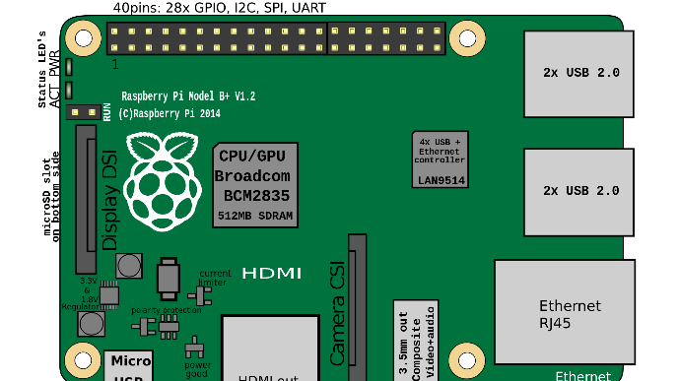


1.Send the captured image from the pi to our server machine
3. Store the processed value of the images in DynamoDB
2. Send the processed image result from the server machine back to the pi
AWS Dynamo DB

Slide 7
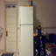
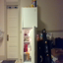

Slide 8
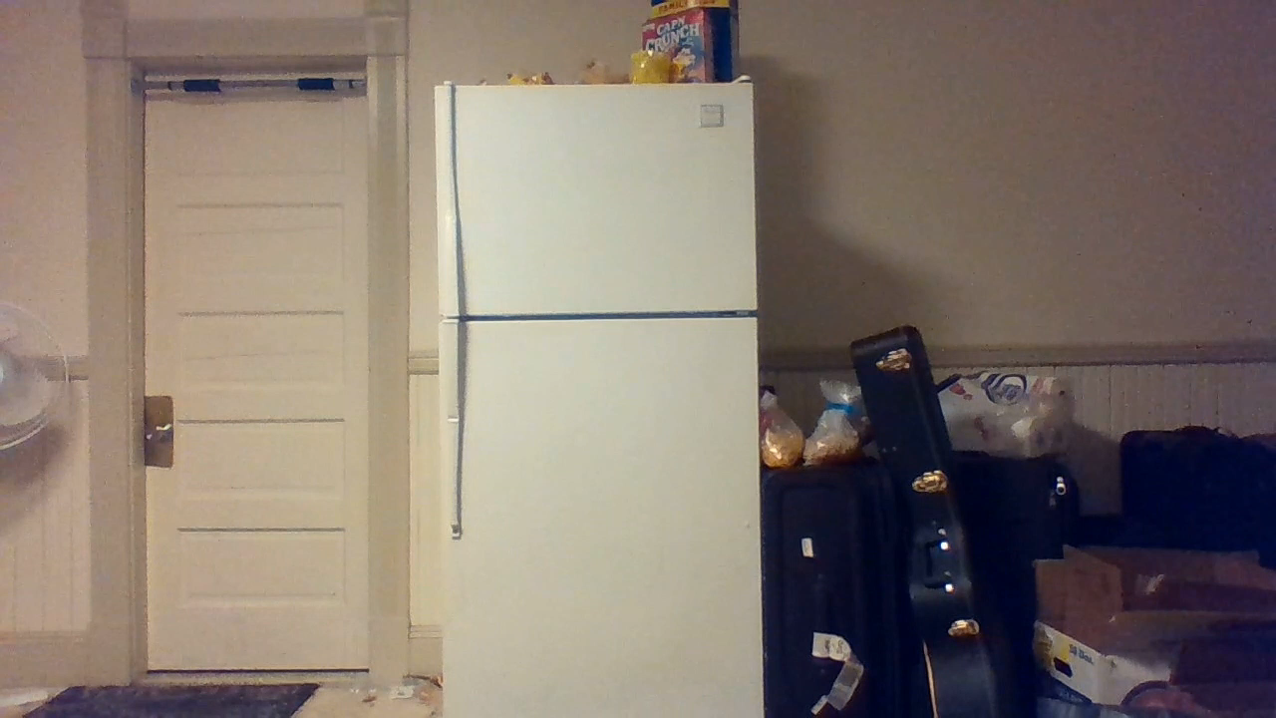

Slide 9
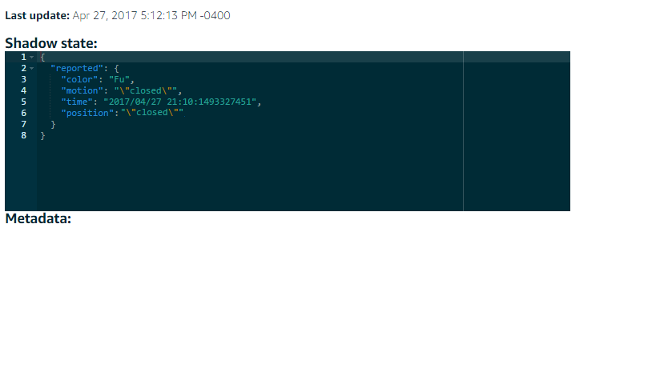
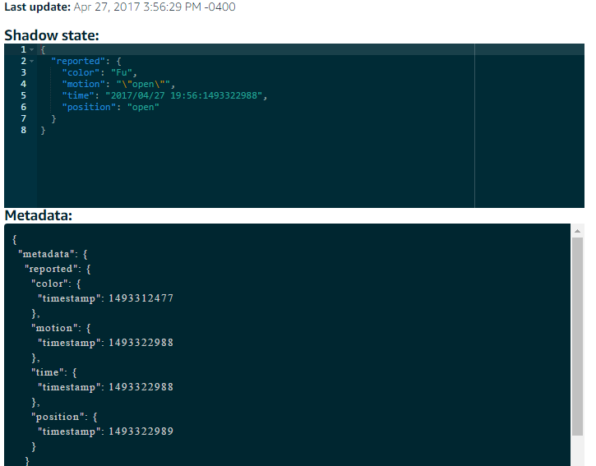
AWS & Dynamo DB
The RasberryPi was connected to the Amazon IoT Python SDK
Below are the screenshots showing the results of the shadow state, shadow metadata and the data that was stored in the DynamoDB.

Slide 10
Thank You !!!

